Slide 1
Basketball Ground
Using OpenGL 3.3
Presented By,
Ankan Saha
Roll: 1807060

Slide 2
Control Buttons
H → Move Eye Along Positive X axis
F → Move Eye Along Negative X axis
R → Move Eye Along Positive Y axis
Y → Move Eye Along Negative Y axis
T → Move Eye Along Positive Z axis
G → Move Eye Along Negative Z axis
L → Increase Look At point along X axis
J → Decrease Look At point along X axis
U → Increase Look At point along Y axis
O→ Decrease Look At point along Y axis
I → Increase Look At point along Z axis
K → Decrease Look At point along Z axis
W → Human Move Forward
S → Human Move Backward
A → Human Move Left
D → Human Move Right

Slide 3
Control Buttons
E → Increase Ball Velocity
R → Decrease Ball Velocity
UP → Increase Vertical Angle
DOWN → Decrease Vertical Angle
LEFT → Increase Horizontal Angle
RIGHT → Decrease Horizontal Angle
1 → Point Light Turn ON/OFF
2 → Directional Light Turn ON/OFF
3 → Spot Light Turn ON/OFF
SPACE → Throw Ball

Slide 4
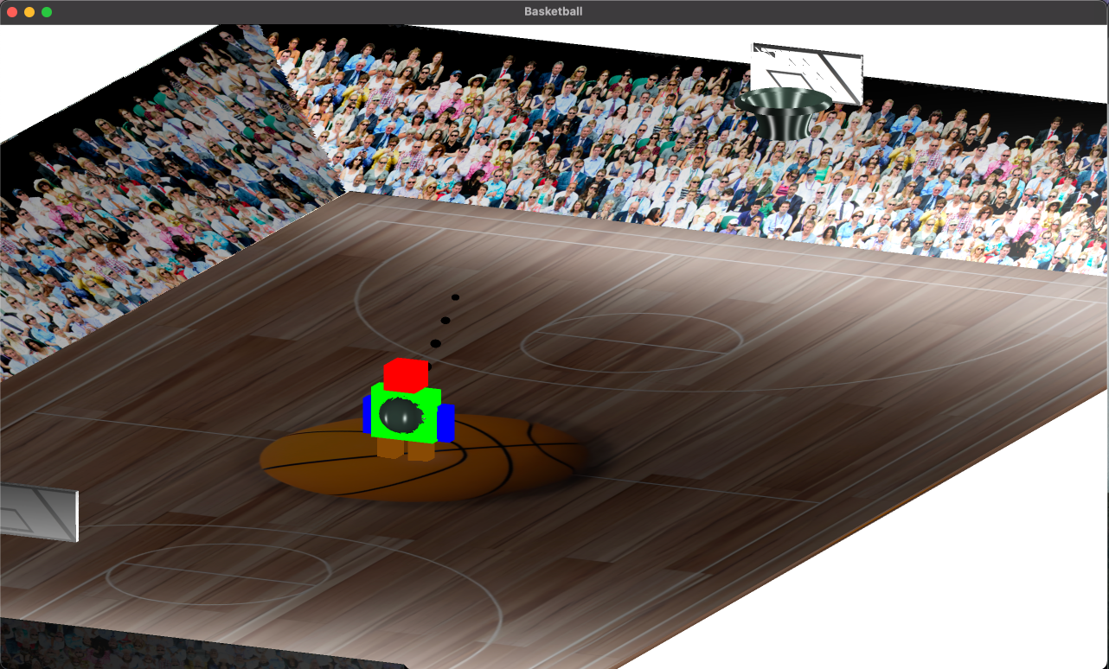
Point Lights

Slide 5
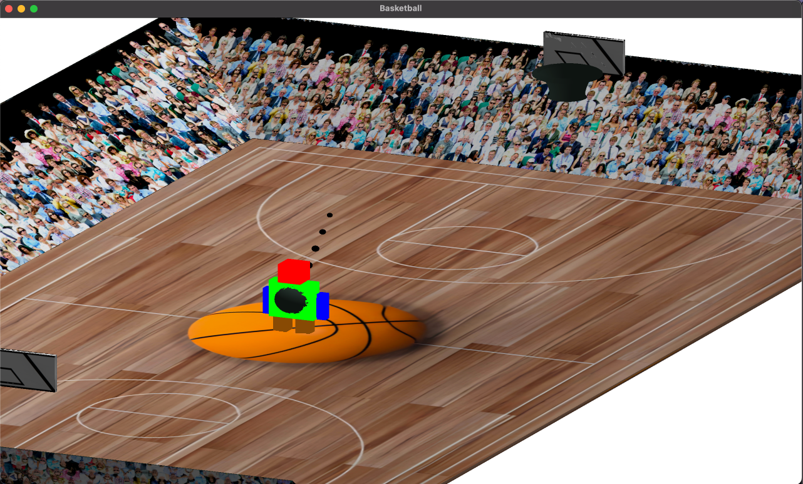
Directional Light

Slide 6
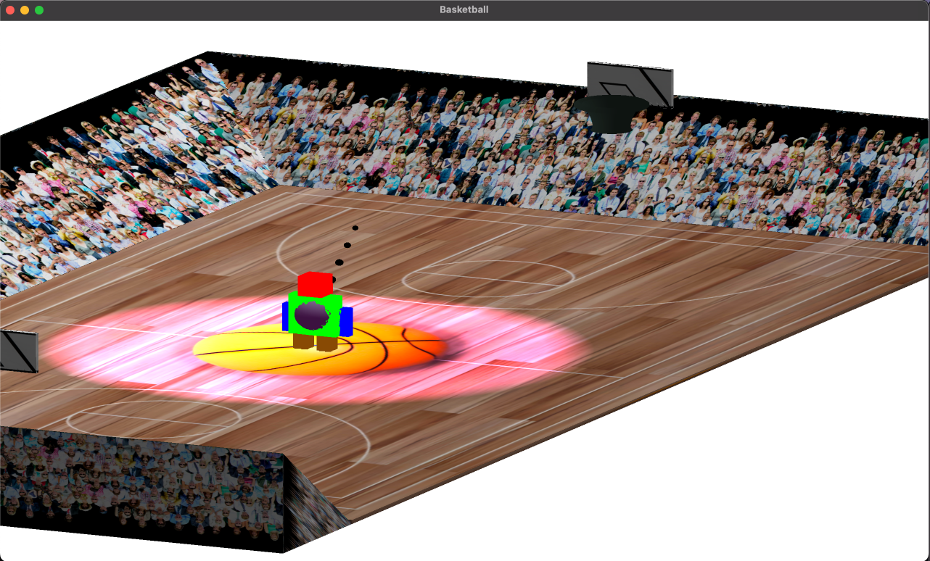
Spot Light

Slide 7
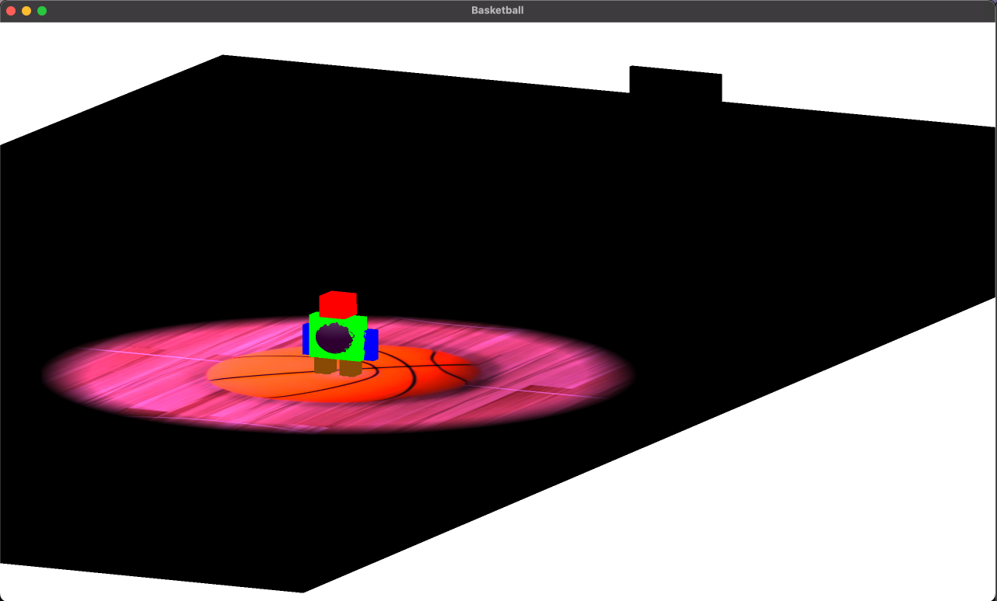
Spot Light

Slide 8
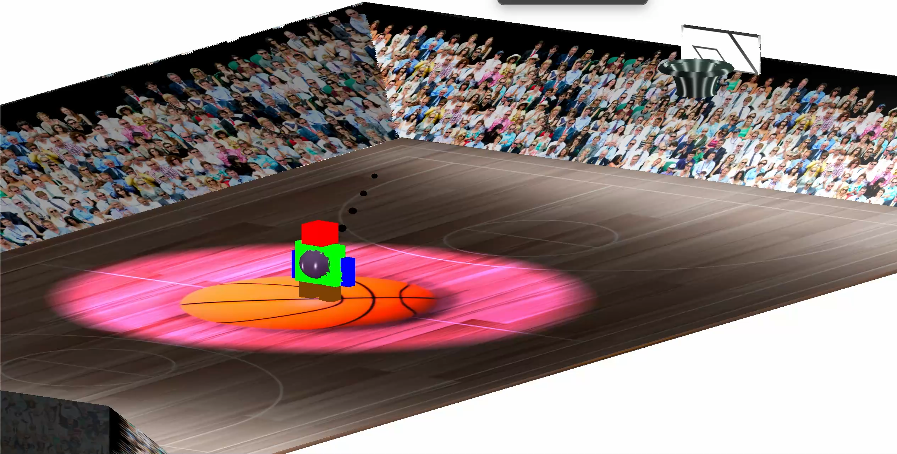
Moving Spot Light

Slide 9
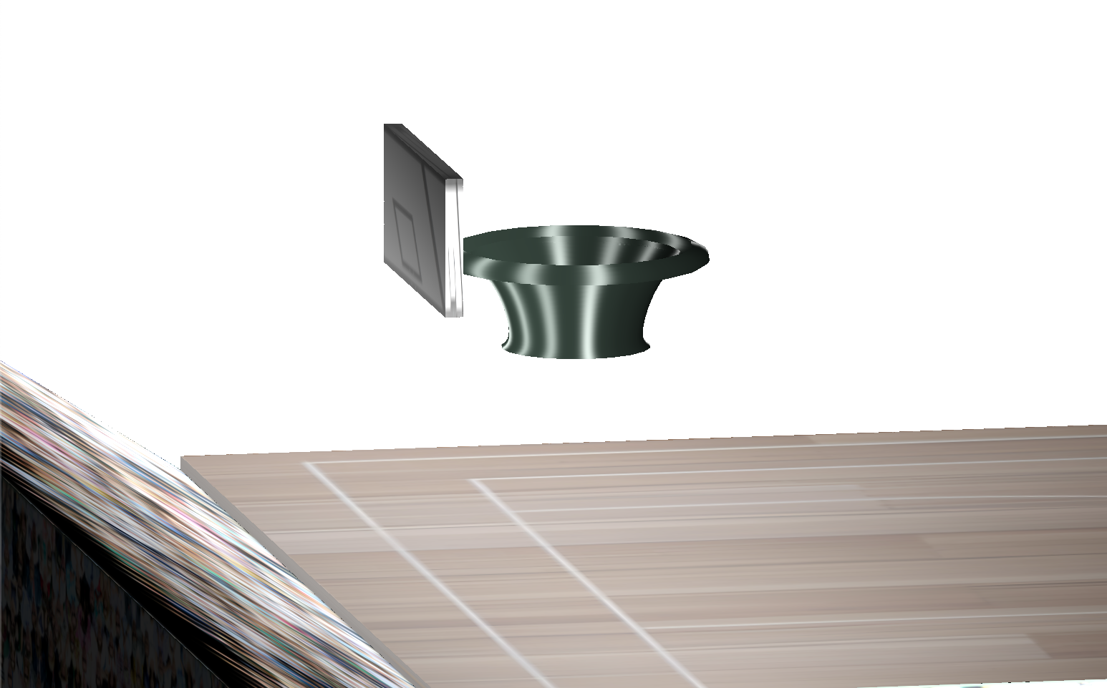
Ball Ring (Made using Curve)

Slide 10
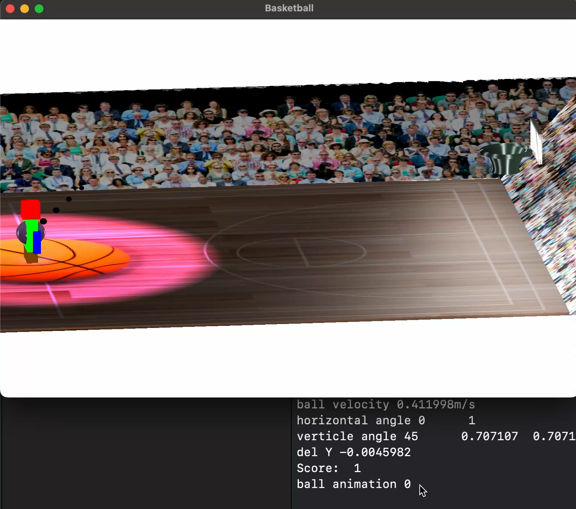
Throwing Ball

Slide 11
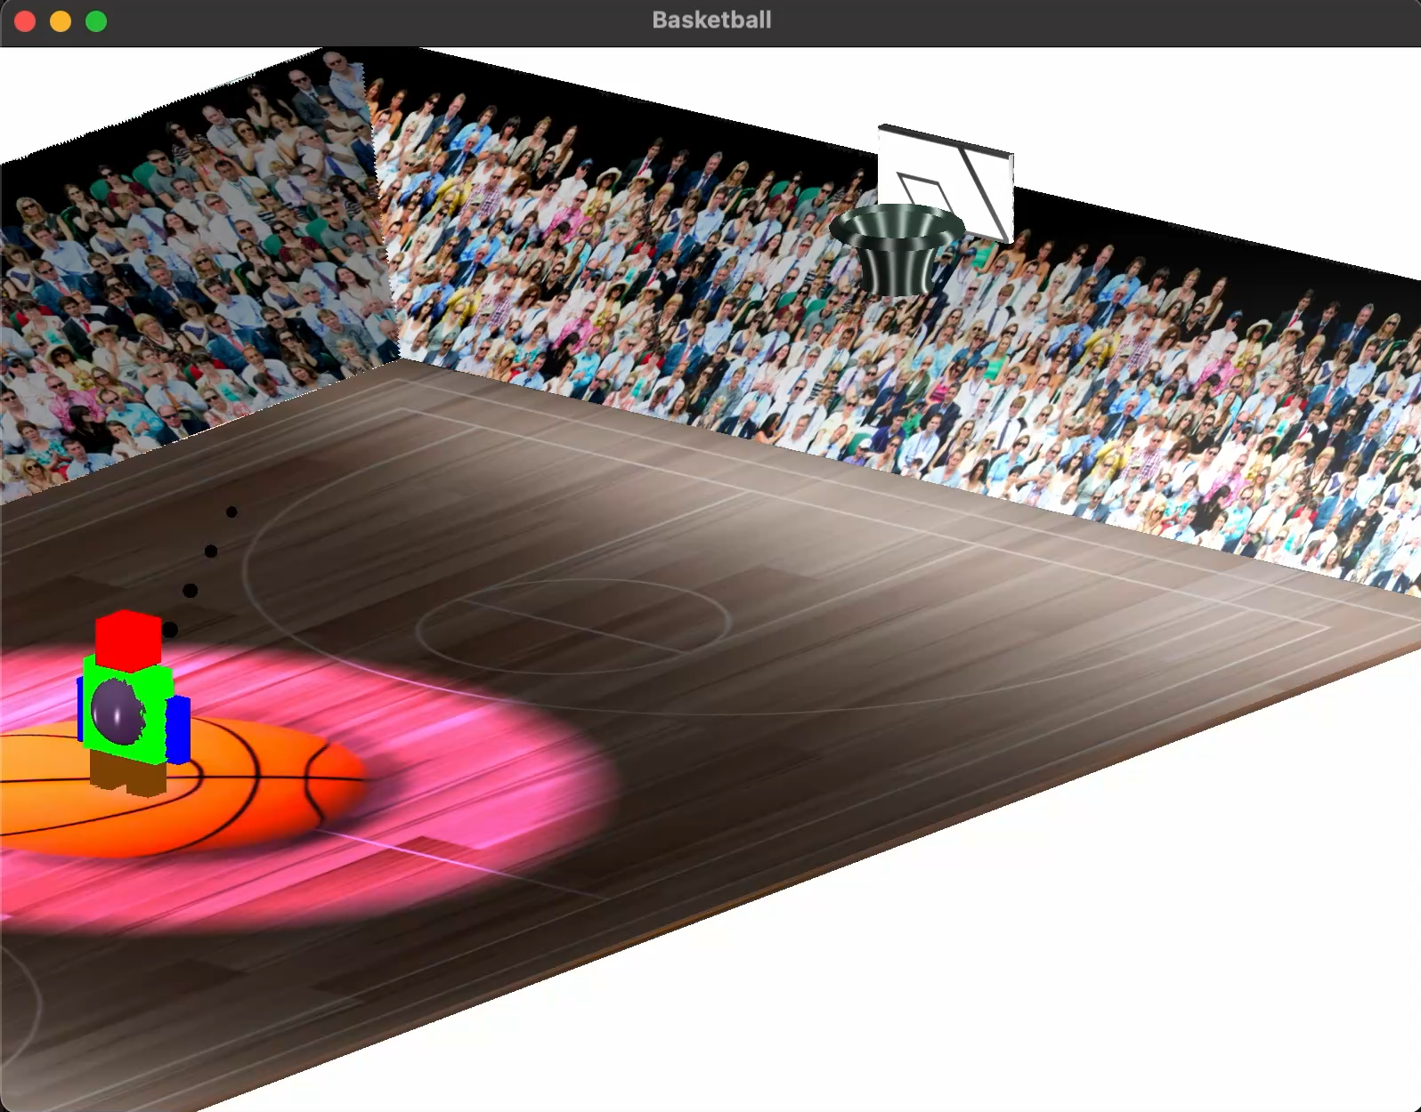
Throwing Ball

Slide 12
Mathmatics Behind the Scene
Y
∆t = 1 unit
∆x =V cos(θ_{V}) cos(θ_{H}) * ∆t
= V cos(θ_{V}) cos(θ_{H})
∆z =V cos(θ_{V}) sin(θ_{H}) * ∆t
= V cos(θ_{V}) sin(θ_{H})
V
V sin(θ_{V})
θ_{V}
X
V cos(θ_{V}) sin(θ_{H})
θ_{H}
V cos(θ_{V})
V cos(θ_{V}) cos(θ_{H})
Z

Slide 13
Mathmatics Behind the Scene
∆y = U – 0.5*G
U = V (Update initial velocity)
V = U – G*∆t = U - G
S = U*∆t – 0.5*G*∆t² = U – 0.5*G
X
U = V cos(θ_{V})
G=9.8
∆t=1

Slide 14
Mathmatics Behind the Scene(case study)
Y
Not
Goal!!!
Goal!!!

Slide 15
THANK YOU

